Slide 1
Residency Action Info Session

Slide 2
Culture Moves Europe
Culture Moves Europe provides mobility grants for artists and cultural professionals in all 40 Creative Europe countries.
The scheme consists of 2 action lines: Individual Mobility and Residencies.
Contributes to travel and subsistence costs, and offers additional top-ups based on the grantee’s individual situation. Specific measures are also taken to encourage green mobility.
It is funded by the European Union and implemented by the Goethe-Institut.

Slide 3
Culture Moves Europe: 2 Actions
Individual Mobility Action
6.000 grantees
Residency Action
1.000 artists and cultural professionals
Individual Mobility Action
6.000 grants
Individual Mobility Action
6.000 grants
For individual artists and cultural professionals willing to implement a project in another Creative Europe country with an international partner.
For legal entities (private organisations, non-profit, foundations, public bodies, persons, etc.) who want and have the capacity to welcome artists and cultural professionals for a residency project.
Launch: October 2022
Launch: March 2023
Notes:
2 main actions with different target groups and rules.
2 calls documents
Different aims but inerlinked.

Slide 4
Eligible Sectors
*Architecture
*Cultural heritage
*Design and fashion design *Literary translation *Music *Performing arts *Visual arts
Individual Mobility Action
6.000 grants
Culture Moves Europe covers all the cultural and creative sectors from the CULTURE Strand of Creative Europe programme:

Slide 5
40 Creative Europe Countries, including OCTs and ORs
Albania, Austria, Armenia, Belgium, Bosnia-Herzegovina, Bulgaria, Croatia, Cyprus, Czech Republic, Denmark, Estonia, Finland, France, Georgia, Germany, Greece, Hungary, Iceland, Ireland, Italy, Kosovo*, Latvia, Liechtenstein, Lithuania, Luxembourg, Malta, Montenegro, Netherlands, North Macedonia, Norway, Poland, Portugal, Romania, Serbia, Slovakia, Slovenia, Spain, Sweden, Tunisia, and Ukraine. *This designation is without prejudice to positions on status, and is in line with UNSCR 1244/1999 and the ICJ Opinion on the Kosovo declaration of independence.
Overseas Countries and Territories (OCTs) and Outermost Regions (ORs)
Greenland (Denmark);
French Guiana, French Polynesia, French Southern and Antarctic Territories, Guadeloupe, Martinique, Mayotte, New Caledonia, Reunion Island, Saint Barthelemy, Saint-Martin, St. Pierre and Miquelon, Wallis and Futuna Islands (France);
Azores, Madeira (Portugal);
Canary Islands (Spain);
Aruba, Bonaire, Curaçao, Saba, Sint Maarten, Sint Eustatius (The Netherlands)

Slide 6
What? financial support
To whom? to legal entities (organisations and individuals)
For what? to host artists and cultural professionals (A&CPs) for a residency project
1st Call open:
from 15 March 2023
until 15 June 2023!
Notes:
Call timeline
Briefly mention the next calls, autumn and year 2024. in total 4 calls. Possible to reapply.

Slide 7
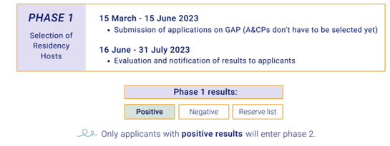
Call for Residency Hosts:
A 2-Phase Application and Funding procedure
Notes:
2 phase procedure – mainly because we wanted to give flexibility and select the artists once you know you are awarded.
But all information needed to conclude and sign the grant agreement are in phase 2-residency info card.
Explain the 2 phases – actions and overall timeline

Slide 8
Phase 1: Selection of Residency Hosts
Notes:
2 phase procedure – mainly because we wanted to give flexibility and select the artists once you know you are awarded.
But all information needed to conclude and sign the grant agreement are in phase 2-residency info card.
Explain the 2 phases – actions and overall timeline

Slide 9
Phase 1: Selection of Residency Hosts
Eligibility criteria for legal entities
Legal entity can be:
a non-profit organisation, NGO, public body, foundation, company, self-employed person, etc.
newly founded or a well-established entity
registered and based (in the same country) in a Creative Europe country.
Active in at least one of the eligible sectors of CULTURE strand.
have capacity (i.e. facilities, services, support from mentor, staff) to implement an artistic and cultural residency project in which they host between 1 & 5 A&CPs.
Notes:
Who can apply ?
If legal entity has 2 characteristics the chose to register with only 1 – needed for data analysis from our side, t know who we are reaching.
Application criteria

Slide 10
Phase 1: Selection of Residency Hosts
Eligible applications
Applications in English language (proficiency not evaluated).
Maximum of 1 application for each call.
Ineligible application to support retroactively for residencies and/or projects already completed in the past or which already started before the signature of the grant agreement.
Notes:
Who can apply ?
If legal entity has 2 characteristics the chose to register with only 1 – needed for data analysis from our side, t know who we are reaching.
Application criteria

Slide 11
Phase 1: Selection of Residency Hosts
The residency project
Applicants apply with a residency project, with a specific concept and objectives, in which the invited A&CPs will take part.
Participating A&CPs can develop their own individual project, depending their field, but remain under the proposed concept/project.
Notes:
Difference between the residency project and the work of each artist.
Artists can be from different sectors/professions . Ex. 2 dancers and 1 visual arts.
More about artists in phase 2 slides, in a while. ☺

Slide 12
The residency project
The aim of the residency project can be 1 or 2 of the below objectives:
To explore: to conduct research, to investigate and work on a specific theme or a new concept.
To create: to engage in a collective creative process seeking to produce a new piece of artistic/cultural work.
To learn: to enhance the participants’ competences and skills through non-formal learning or collaboration with a specialist.
To connect: to develop a professional network, to strengthen the participants’ professional development, to engage with new audiences.
To transform: to contribute to societal change in line with the New European Bauhaus values and principles.
Notes:
Last objective is in line with the New European Bauhaus values and principles - more information about it are given in the call.
Pg. 8

Slide 13
The residency project specifications
Duration:
Short-term residency between 22 days and 60 days.
Medium-term residency between 61 days and 120 days.
Long-term residency between 121 days and 300 days.
Participating A&CPs should do the residency at the same time (same dates) for the same duration. Each of them present at the premises the 70% of their time.
It should be uninterrupted.
Must take place and finish within 1 year from the signature of the grant agreement.
Location:
It must take place in one location, at the Creative Europe country where the legal entity is registered and based.

Slide 14
What is the role of the host ?
Hosting coordinator: The main person of contact with the Culture Moves Europe team, from the application phase through to the reporting at the end of the residency project.
Legal representative: The person responsible for signing all official documents, such as the grant agreement. This person is legally responsible and liable towards the European Commission and the Goethe-Institut.
Mentor: The person associated to the host (staff member or collaborator) who provides feedback and guidance to the participating A&CPs. Responsible to deliver the mentoring activities, ex. individual weekly feedback time, group guidance/project progress check-in.
Notes:
Administration – coordination → the one applying, and in contact with CME team –always the same to avoid confusion.
Legal matters , signature and agreements
Mentor needs to have the professional background to support artistically the residents.
The same person can have 3 roles and responsibilities.

Slide 15
Evaluation process and criteria
Premises and services (5/20 points): working environment, accommodation, coordination support, etc.
Selection of artists and cultural professionals (2/20 points): explanation and justification of the selection process of the participants.
Collaborative environment (3/20 points): collaboration between participants and the host, mentoring activities, etc.
Relevance of the residency project (6/20 points): alignment with the action objectives, host’s work and activities.
Outcomes and impact (2/20 points): long-term outcomes for the host, the participating A&CPs, the local and national artistic and cultural ecosystem.
Sustainability aspects (2/20 points): use of sustainable practices and material.
Notes:
Read for each one some questions from the call. Pg. 12-13

Slide 16
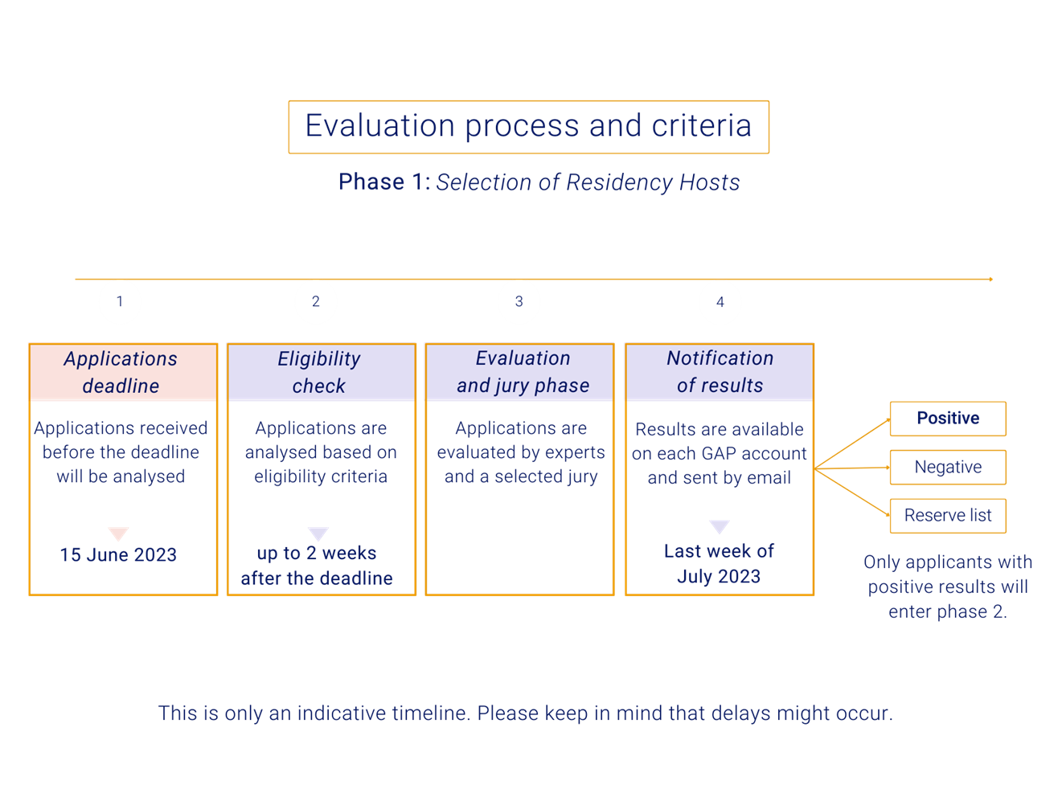
Notes:
Eligibility check: Culture Moves Europe checks that the application is fully completed and complies with the eligibility criteria (see figures 2 and 4), including the supporting documents (see 1.6).
Evaluation: Each eligible application is evaluated by two external experts from the Culture Moves Europe evaluators’ pool. Evaluators work independently from one another. Evaluators follow a strict evaluation grid (see figure 5), and sign a declaration of non-conflict of interest. The evaluators are selected for their expertise in the different sectors and from the different countries covered by the scheme.
Please note: Applications with a score of less than 10 points out of 20 (see 1.3.2) will be automatically excluded from further evaluation.
Jury: A jury committee validates the final selection of hosts. The jury is composed of representatives from the European Commission and the Goethe-Institut e.V., and ensures the quality, impartiality and coherence of the selection process. The selected projects will reflect the quality of the application (based on evaluators’ score), as well as other criteria such as geographical and sectoral balance.
Notification: The results of the call are communicated individually to applicants via the Goethe-Application Portal:
Positive: successful applicants are invited to proceed to Phase 2, where they have to select the participating A&CPs and confirm the details of the residency project.
Negative: ineligible applications, applicants below the selection threshold.
Reserve list: applicants on the reserve list can be offered to go through Phase 2 and select A&CPs at a later stage, only if previously selected applicants drop out from the funding opportunity. In such cases, the deadline for selecting A&CPs will be determined by Culture Moves Europe. Applicants on the reserve list may be contacted by Culture Moves Europe until 15 November 2023. After 15 November 2023, applicants on the reserve list will be automatically considered as rejected, without any further notification by Culture Moves Europe. Applicants will be entitled to re-apply to other Culture Moves Europe calls.

Slide 17
^{[1]} To see examples of proof, please check Section 5.4.2
^{[2]} Green transports includes all types of transport except airplane, in order to go from the country of residence to the country of destination.
^{[3]} More information available here: www.atmosfair.de
The Residency Grant
Allocated to the host
A. Hosting costs
Fixed amount to contribute to expenses related to the implementation of the residency project.
Includes: accommodation for the A&CPs, mentor fees, renting equipment, etc.
Per A&CP/per day: €35
Notes:
The residency grant is calculated based on the number of participating A&CPs and the length of the residency project. A budget will be estimated at Phase 1 based on the information provided in the application to the Call for Residency Hosts.
The exact amount of the grant will be confirmed after the selection of the hosts, at Phase 2, upon approval of the residency info card (see 2.3) and signature of the grant agreement. For more information on the calculation of the support, see Section 2.5.
Please note that Culture Moves Europe operates on a lump sum approach = amounts granted regardless of the actual expenses.

Slide 18
^{[1]} To see examples of proof, please check Section 5.4.2
^{[2]} Green transports includes all types of transport except airplane, in order to go from the country of residence to the country of destination.
^{[3]} More information available here: www.atmosfair.de
The Residency Grant
Allocated to each A&CP
B1. Daily Allowance
Contribution to food expenses, local transports, etc. (of the A&CP).
Per A&CP/per day: €25
B2.Travel Allowance
Travel distance
Less than 600 km
Travelling by airplane is only allowed in exceptional and well justified cases.
Per A&CP: €350
Travel distance
600 to 5.000 km
The applicant can choose whether to travel by airplane or another means of transportation.
Per A&CP: €350
Travel distance
5.001 km and more
The applicant can choose whether to travel by airplane or another means of transportation.
Per A&CP: €700

Slide 19
^{[1]} To see examples of proof, please check Section 5.4.2
^{[2]} Green transports includes all types of transport except airplane, in order to go from the country of residence to the country of destination.
^{[3]} More information available here: www.atmosfair.de
The Residency Grant
Allocated to each A&CP
C. Top-ups
Visa Top-Up
For expenses related to visa processes.
Per A&CP: €80
OCTs and ORs Top-Up
For travelling to or from Overseas Countries and Territories or Outermost Regions.
Per A&CP: €150
Disability Support
For people whose disabilities affect their ability to carry out the mobility project.
Bugdet to be agreed with the Culture Moves Europe team according to individual needs.
Per A&CP: Up to €75 per day
Family Top-Up
For participants with children below the age of 10. The amount is fixed, regardless of the number of children.
Per A&CP: €100
Green Top-Up
For choosing not to travel by airplane (outward and return). Only applicable for journeys of 601km or more.
Per A&CP: €350
Notes:
Top-ups are given only if applicable – if there is a need and is proven.
Proofs later in application and residency info card slides.
Green top-up: fixed amount of €350 per participant travelling more than 600km (distance calculated one-way) who choose to take any form of transport other than airplane, from the place of residence to the place of destination, and back to the place of residence.
Visa expenses: fixed amount of €80 for expenses connected to visa applications.
OCTs/ORs top up: fixed amount of €150 for participants whose place of residence and/or place of destination is an Outermost Region (OR) or Overseas Country and Territory (OCT) (see section 1.1). It covers travel from the place of residence to the place of destination, and back to the place of residence.
Family top-up: fixed amount of €100, for participants who have at least one child below the age of 10, regardless of the number of children and of the child/children joining the residency project.
Disability support: up to €75 per day for participants whose disability affects their ability to carry out their mobility project. Exceptional cases to be communicated with the Culture Moves Europe team.

Slide 20
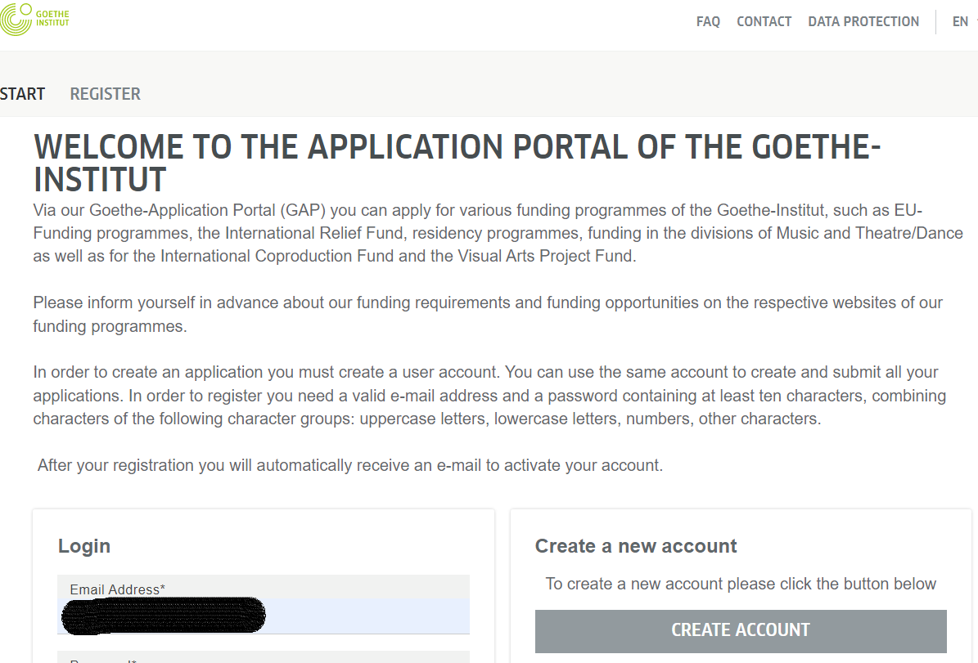
The Application process
Application open from 15 March until 15 June 2023 23:59 CEST.
Online form available at Goethe-Application Portal – need to create an account.
Register as: Organisation/Enterprise
Link: https://gap-online.goethe.de/en-US/
Notes:
To Gloria: if they already have an account for IM , they should create a new one as an organisation…right ?
Add GAP link in the chat that moment.
The application must be submitted in English, but the supporting documents are accepted in any of the officially acknowledged languages of the Creative Europe countries. Participants may however be requested to submit English translations (unofficial, using online tools) to facilitate the validation process.
Please note: Documents are considered as official when they are delivered by official national authorities. Supporting official documents cannot be replaced by self-declarations or by sworn or solemn statements before judicial or administrative authorities, notaries or public officers.

Slide 21
Notes:
Each section to provide information about your organisation, the project etc. – characters limit – we prefer to have detailed replies and not just 2 sentences
It makes the application more valid – more chances to be awarded having more information.

Slide 22
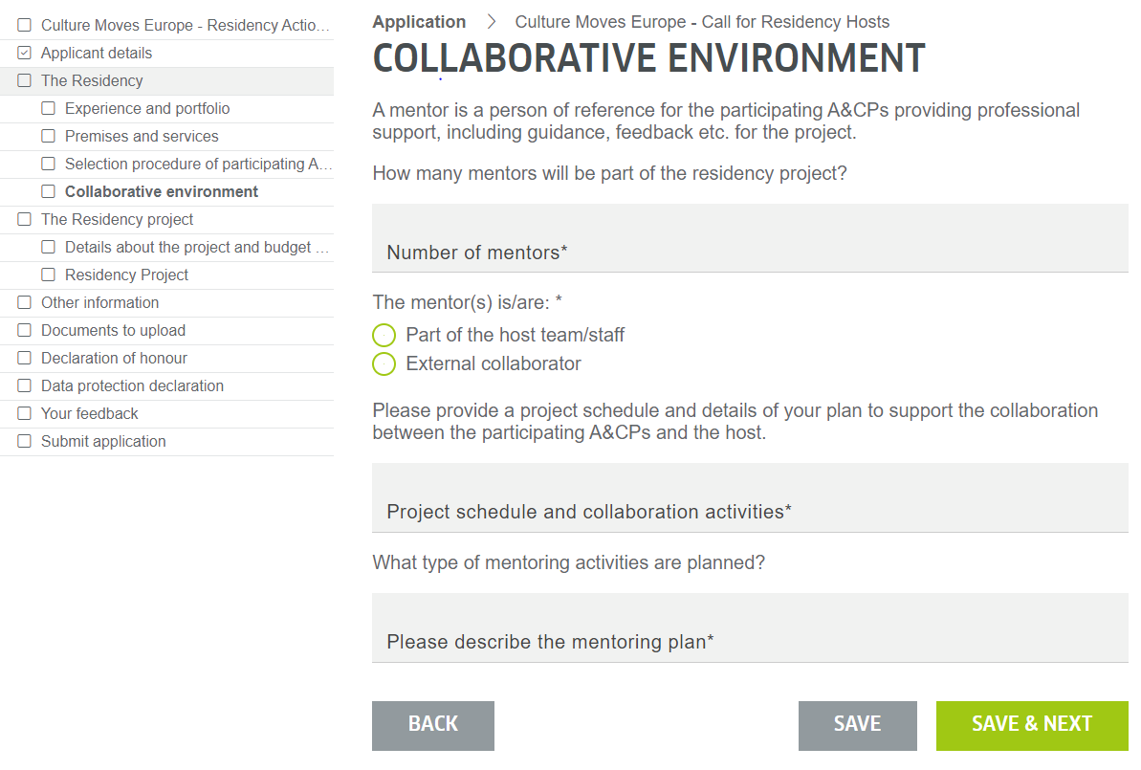
The Application process
Notes:
Open and close questions
Drop down boxes
**Question needs to be replied
Schedule: briefly for each day or week if it’s a longer period. Maybe describe here the phases o the project and the main activities related to it. Ex. Research /experiment 3 weeks and final exhibition last 2 weeks, etc,

Slide 23
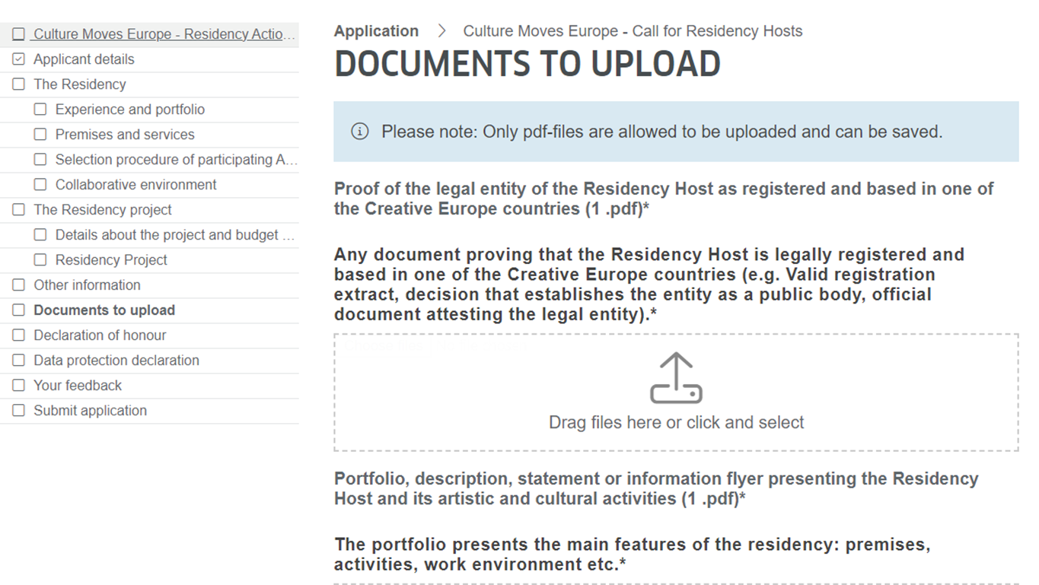
The Application process
Documents to submit
Proof of legal entity registered and based in one of the 40 CE countries.
- registration extract or
- decision that establishes it as a public body or
- official document attesting the legal entity
2. Portfolio/report presenting the relevant experience of the organisations and staff. If new entity, a letter of intention with future plans is enough.
3. CV of the mentor(s)
Notes:
Most cases will be → a Registration extract document: Registered as a business – paying TAX in this country, etc. - no need to have it translated in English
Public bodies cannot have a registration extract – proof of the status is enough.
3rd document more flexible – open cases

Slide 24
Phase 2: Grant Agreement with Residency Hosts
(For applicants with a positive result)

Slide 25
Phase 2: Grant Agreement with Residency Hosts
Selection process of the participating A&CPs
Standard call of your organisation.
Specific open call.
Nomination/Direct invitation to artists/cultural professionals.
Hosts are allowed to combine different ways to select their participants.
Notes:
Selection process:
Standard call of your organisation – as long as the objectives match your evaluated residency project.
Specific open call for the residency project, with specific information – shorter period maybe more manageable.
Nomination/Direct invitation – need to justify in the application why this person, (added value or already a built collaboration, etc.)
Mixed way , ex. you nominate an artist you know and fits and open a call for 2 others.
In any case it should be explained and well justified in the application.
Mention here that if they already know who their participants will be it is totally fine. The residency info card will open from 1st august and they can already be collecting the needed documents to be ready to submit.

Slide 26
Phase 2: Grant Agreement with Residency Hosts
Selection process of the participating A&CPs
Match – making sessions
Culture Moves Europe will organise match-making sessions to bring together interested hosts and artists/cultural professionals.
in September 2023
to support the promotion of residency projects and facilitate collaborations
Notes:
Who can participate ..?
Mixed way , ex. you nominate an artist you know and fits and open a call for 2 others.
In any case it should be explained and well justified in the application.
Mention here that if they already know who their participants will be it is totally fine. The residency info card will open from 1st august and they can already be collecting the needed documents to be ready to submit.

Slide 27
Phase 2: Grant Agreement with Residency Hosts
Eligibility criteria for participating A&CPs
Participants must legally reside in another Creative Europe country from where the host is based, thus where the residency is implemented.
Active in the sectors of CULTURE strand and willing to work on their field to develop a project.
Aged 18+.
Groups or individuals.
Allowed to have the same nationality as the country where the residency is implemented.
Allowed to have received an Individual Mobility grant from Culture Moves Europe or an I-portunus House grant.
Notes:
Who can participate ..?
In the case of a group ex. a band, or circus ensemble probably the selection is through a direct invitation.

Slide 28
Phase 2: Grant Agreement with Residency Hosts
Residency Info card
When: submit from 1 August to 15 October 2023 (on GAP).
Objective: Provide and confirm the following information to calculate the exact residency grant amount :
Exact dates and duration
Participants’ details
final travel itinerary
need for tops ups, etc.
Changes from the application very limited in specific situations.
Documents to submit with the card:
Proof of legal residence at one of the 40 CE countries for each A&CP: ex. ID, passport, residence card, work permit, etc.
2. Proof for disability support and family top-up (if applicable).
Notes:
Mention that the grant as presented in phase 1 does not cover insurance or taxation. This is the responsibility of each host and/or participant depending the duration of the mobility and the rules of the country.
Briefly mention the changes – but do not give focus to avoid discussions
Changes with budgetary implications: If some of the below changes take place, the estimated amount of the residency grant will be recalculated.
Duration of the residency project:
It cannot be longer than initially stated in the application form.
It must be the same duration for all participating A&CPs.
If the hosts want to decrease the duration, it must remain in the same residency type as stated in the application:
Short-term residency project: lasting from 22 days up to 66 days.
Medium-term residency project: lasting from 61 days up to 120 days.
Long-term residency project: lasting from 121 days up to 300 days.
Number of participating A&CPs must be confirmed depending on the results of the A&CP selection process organised by the host:
Hosts cannot select more A&CPs than initially indicated in the application.
With residency projects consisting of more than one A&CP, hosts are allowed to remove only one A&CP.
Changes without budgetary implications:
Human resources and mentorship:
Hosts are allowed to replace the mentor, hosting coordinator and legal representative. More information must be provided in the residency info card.
Location of the residency project:
The location of the implementation of the residency (both residency work premises and accommodation) cannot be changed.
Changes that may arise after signature of the grant agreement are limited and may require an amendement to the grant agreement. Possible changes must be discussed with the Culture Moves Europe team.

Slide 29
Phase 2: Grant Agreement with Residency Hosts
Finalisation of the agreement and payment process
grant agreement between host and Goethe-Insitut.
participant agreement between host and each participating A&CP.
2 tranches payments to the host.
residency report (includes feedback, information about the results, the experience and the rest of the proofs needed) must be submitted at the end of the residency. More information in the Culture Moves Europe Guide.

Slide 30
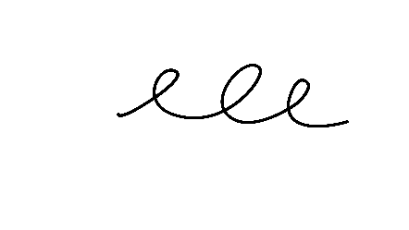
Phase 2: Grant Agreement with Residency Hosts
Payments to the host
1st payment:
60% of the hosting costs
60% of the mobility costs
100% of the disability support
After signature of the grant agreement
Balance payment:
40% of the hosting costs
40% of the mobility grant
100% of the remaining top-ups
After validation of the residency report

Slide 31
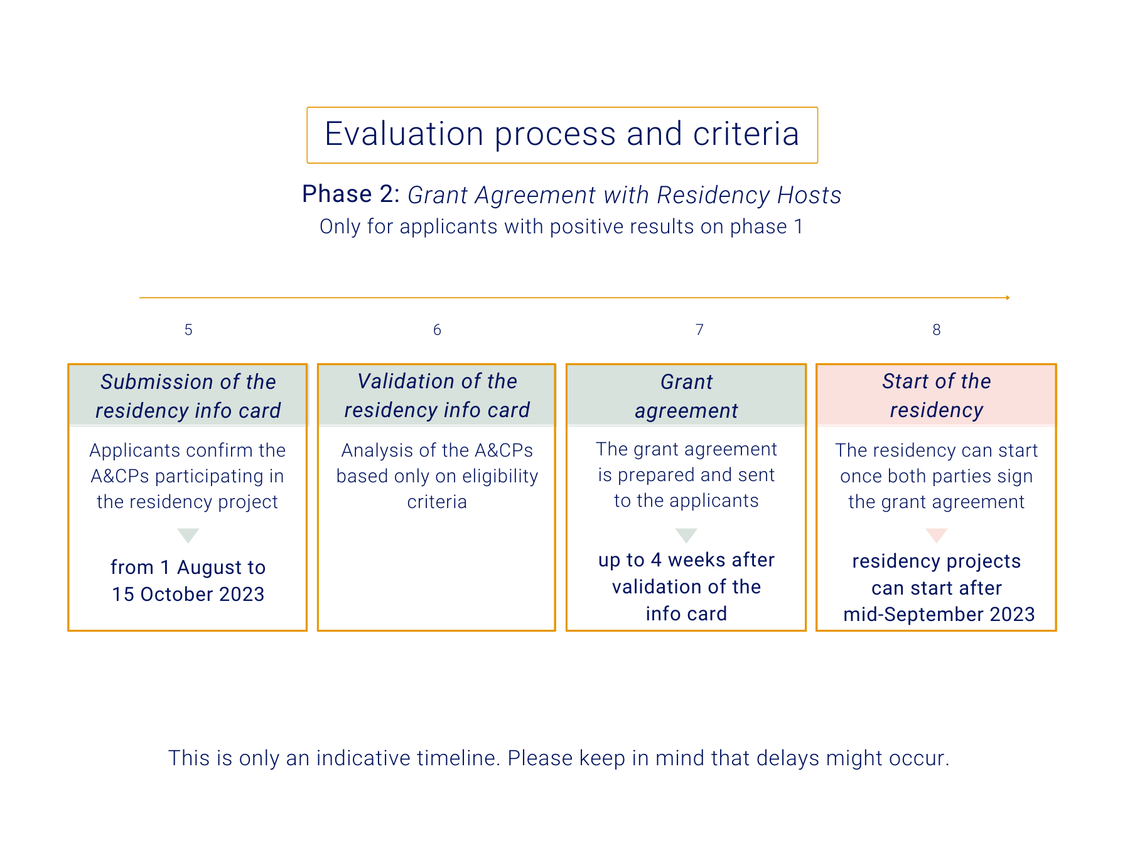

Slide 32
Culture Moves Europe Guide
It will be published soon on the Culture Moves Europe website
https://culture.ec.europa.eu/culture-moves-europe
It aims to provide further information to the selected hosts about:
the grant agreement
changes of the project before and during the implementation
the grant payment and distribution to each participant
participant agreements
publicity and communications
Notes:
This is useful to the selected hosts – in phase 2.
Provide further clarifications. The guide will be included in the grant agreement as an annex..??

Slide 33
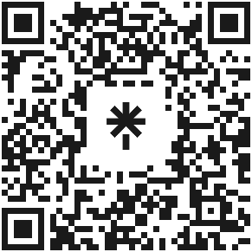
For more information:
Questions about Culture Moves Europe?
Questions about your residency project idea?
Questions about your application?
Website
Info sessions
GAP
Read the Call for Residency Hosts and the FAQ section
Join us for the next session (Approximately 2x/month, on Fridays)
Contact our team directly via the Goethe-Application Portal (GAP)
Social Media
Creative Europe Desk
Email
Follow Culture Moves Europe on social media:
Contact the Creative Europe Desk in your country
Send an email to our team: culturemoveseurope@goethe.de
To access the useful links:
scan this QR Code
or go to:
linktr.ee/CultureMovesEurope

Slide 34
THANK YOU!
Good luck with your application!

